Slide 1

Computer Graphics
Chapter 05
3D Transformations
Asst. Prof. Abdulle Hassan
0618370005
cigaleh@simad.edu.so

Slide 2
Outline
3D Translation
3D Rotation
3D Scaling
Other Transformation

Slide 3
3D Transformation
Now we come to transformations in 3D, where we apply thesame reasoning as in 2D.
Scaling and translation are basically the same, but where in 2D we rotated a shape about a point, in 3D rotation, we rotate an object about an axis.

Slide 4
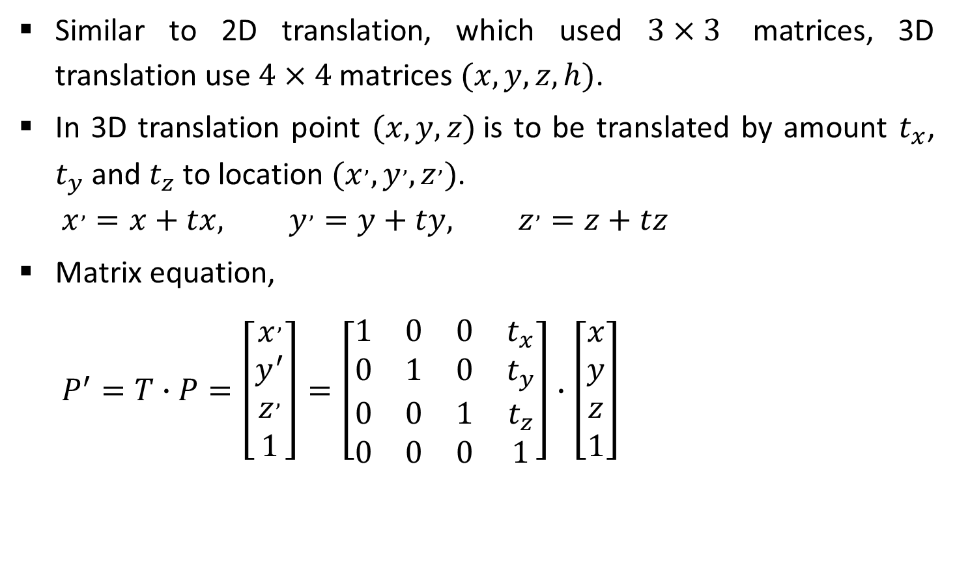
3D Translation
Similar to 2D translation, which used $3×3$ matrices, 3D translation use $4×4$ matrices $(x, y, z, h)$.
In 3D translation point $(x, y, z)$is to be translated by amount $t_{x}$, $t_{y}$ and $t_{z}$ to location $(x^{,},y^{,},z^{,})$.
  $$x^{,}=x+tx, y^{,}=y+ty, z^{,}=z+tz$$
Matrix equation,
  $$P^{′}=T∙P=\left[\begin{matrix}x^{,} \\ y^{′} \\ z^{,} \\ 1\end{matrix}\right]=\left[\begin{matrix}1 & 0 & 0 & t_{x} \\ 0 & 1 & 0 & t_{y} \\ 0 & 0 & 1 & t_{z} \\ 0 & 0 & 0 & 1\end{matrix}\right]∙\left[\begin{matrix}x \\ y \\ z \\ 1\end{matrix}\right]$$
y
(x’, y’, z’)
(x, y, z)
z
x

Slide 5
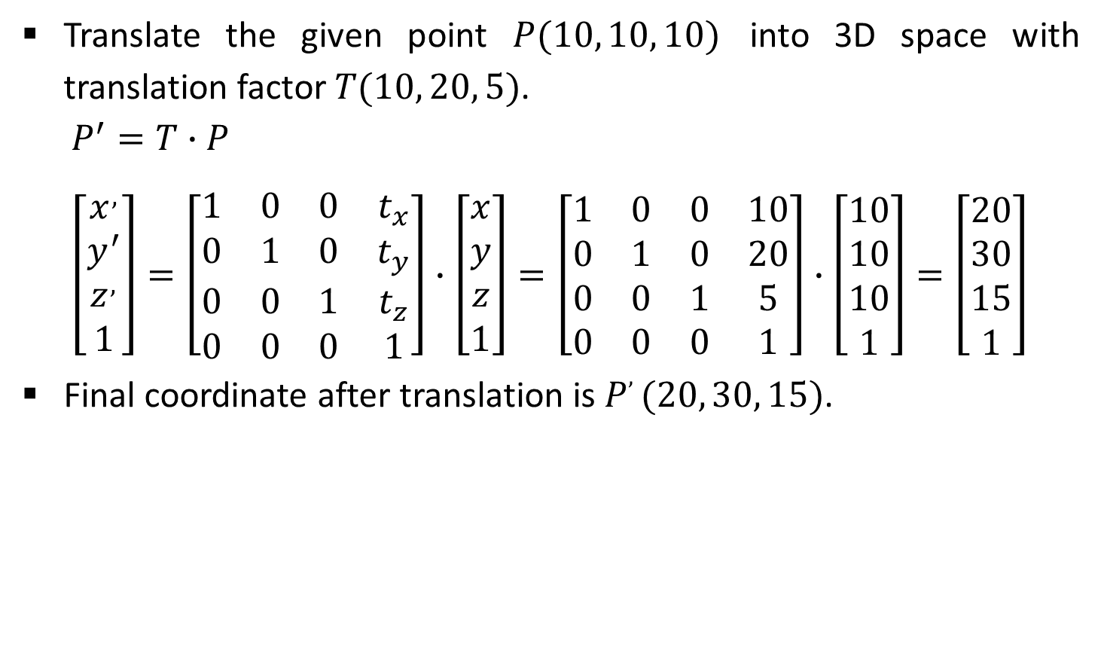
Example- 3D Translation
Translate the given point $P(10, 10, 10)$ into 3D space with translation factor $T(10, 20, 5)$.
  $$P^{′}=T∙P$$
  $$\left[\begin{matrix}x^{,} \\ y^{′} \\ z^{,} \\ 1\end{matrix}\right]=\left[\begin{matrix}1 & 0 & 0 & t_{x} \\ 0 & 1 & 0 & t_{y} \\ 0 & 0 & 1 & t_{z} \\ 0 & 0 & 0 & 1\end{matrix}\right]∙\left[\begin{matrix}x \\ y \\ z \\ 1\end{matrix}\right]=\left[\begin{matrix}1 & 0 & 0 & 10 \\ 0 & 1 & 0 & 20 \\ 0 & 0 & 1 & 5 \\ 0 & 0 & 0 & 1\end{matrix}\right]∙\left[\begin{matrix}10 \\ 10 \\ 10 \\ 1\end{matrix}\right]=\left[\begin{matrix}20 \\ 30 \\ 15 \\ 1\end{matrix}\right]$$
Final coordinate after translation is $P, (20, 30, 15)$.

Slide 6
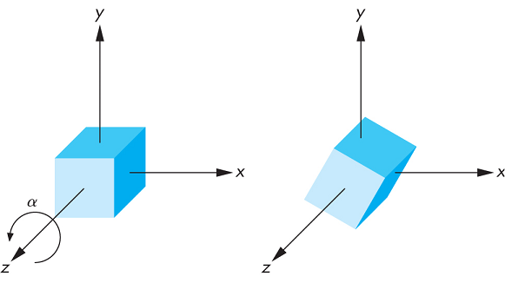

Rotation
For 3D rotation we need to pick an axis to rotate about.
The most common choices are the $X−axis$, the $Y−axis$, and the $Z−axis$, it is known as coordinate axis rotation.
We can also chose other arbitrary axis for rotation.
Source: http://www.c-jump.com

Slide 7
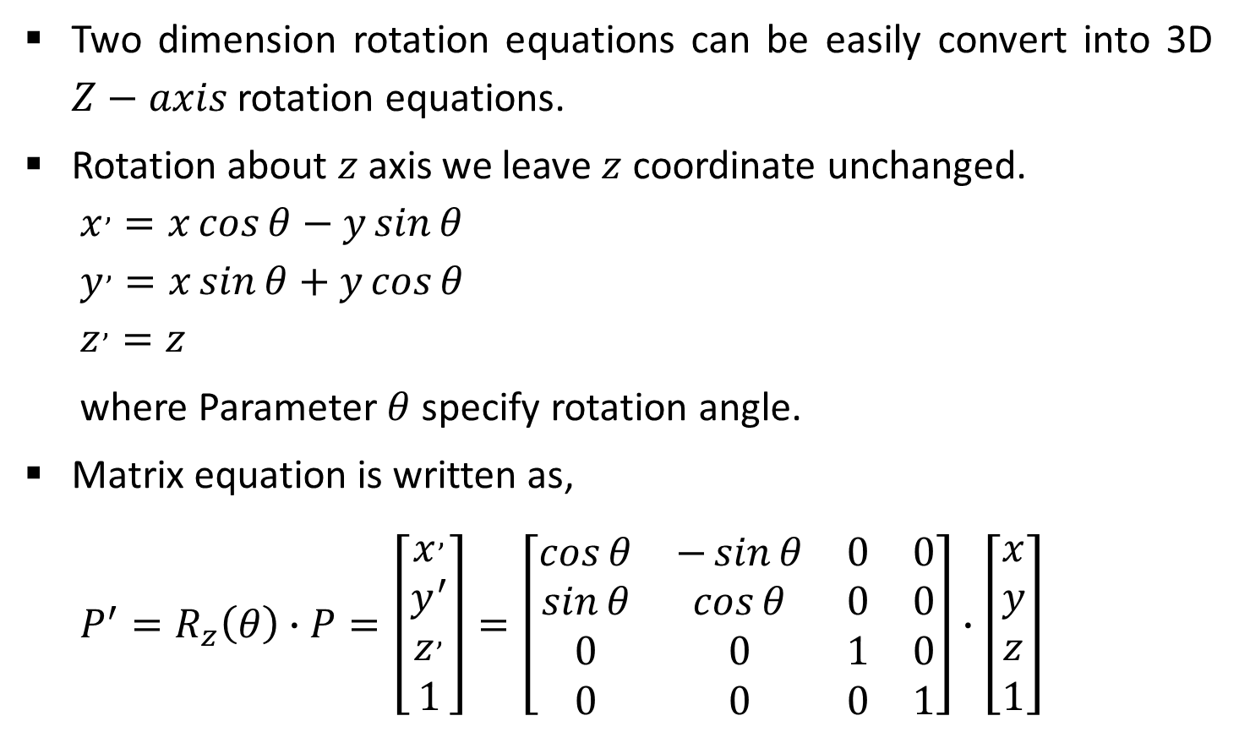
Z-Axis Rotation
Two dimension rotation equations can be easily convert into 3D $Z−axis$ rotation equations.
Rotation about $z$ axis we leave $z$ coordinate unchanged.
  $$x^{,}=x\cos{θ}−y\sin{θ}$$
  $$y^{,}=x\sin{θ}+y\cos{θ}$$
  $$z^{,}=z$$
  where Parameter $θ$specify rotation angle.
Matrix equation is written as,
  $$P^{′}=R_{z}\left(θ\right)∙P=\left[\begin{matrix}x^{,} \\ y^{′} \\ z^{,} \\ 1\end{matrix}\right]=\left[\begin{matrix}\cos{θ} & −\sin{θ} & 0 & 0 \\ \sin{θ} & \cos{θ} & 0 & 0 \\ 0 & 0 & 1 & 0 \\ 0 & 0 & 0 & 1\end{matrix}\right]∙\left[\begin{matrix}x \\ y \\ z \\ 1\end{matrix}\right]$$
Y
X
Z

Slide 8
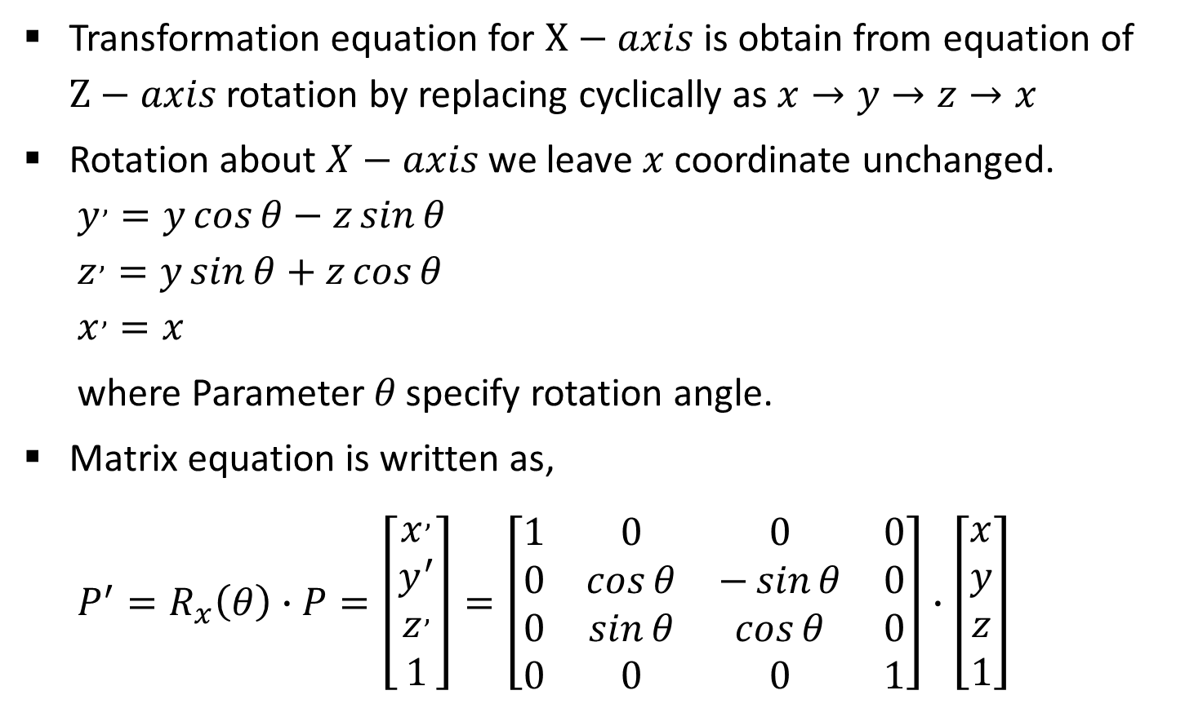
X-Axis Rotation
Transformation equation for $X−axis$ is obtain from equation of $Z−axis$ rotation by replacing cyclically as $x→y→z→x$
Rotation about $X−axis$ we leave $x$ coordinate unchanged.
  $$y^{,}=y\cos{θ}−z\sin{θ}$$
  $$z^{,}=y\sin{θ}+z\cos{θ}$$
  $$x^{,}=x$$
  where Parameter $θ$specify rotation angle.
Matrix equation is written as,
  $$P^{′}=R_{x}\left(θ\right)∙P=\left[\begin{matrix}x^{,} \\ y^{′} \\ z^{,} \\ 1\end{matrix}\right]=\left[\begin{matrix}1 & 0 & 0 & 0 \\ 0 & \cos{θ} & −\sin{θ} & 0 \\ 0 & \sin{θ} & \cos{θ} & 0 \\ 0 & 0 & 0 & 1\end{matrix}\right]∙\left[\begin{matrix}x \\ y \\ z \\ 1\end{matrix}\right]$$
Y
X
Z

Slide 9
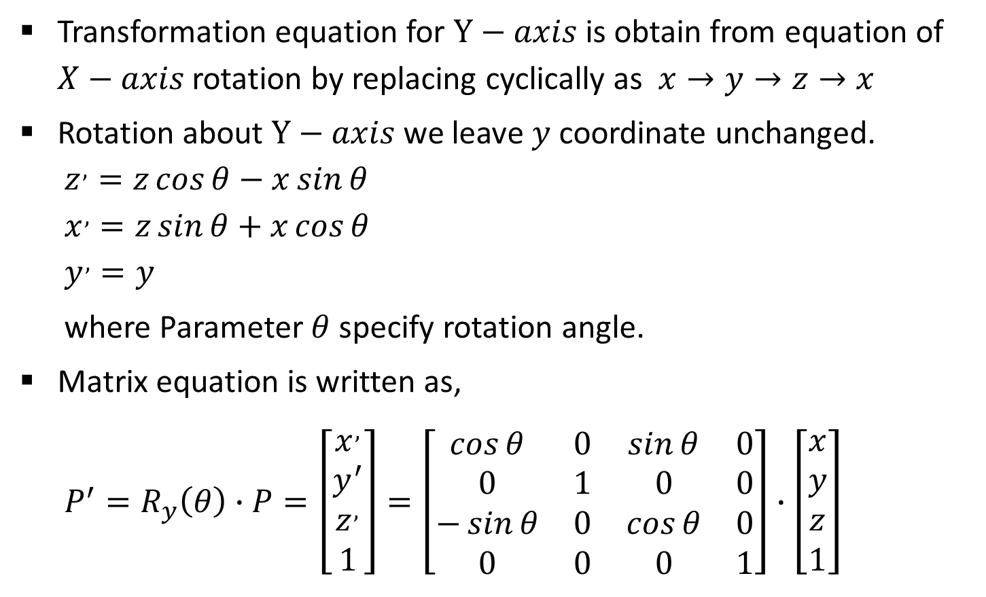
Y-Axis Rotation
Transformation equation for $Y−axis$ is obtain from equation of $X−axis$ rotation by replacing cyclically as $x→y→z→x$
Rotation about $Y−axis$ we leave $y$ coordinate unchanged.
  $$z^{,}=z\cos{θ}−x\sin{θ}$$
  $$x^{,}=z\sin{θ}+x\cos{θ}$$
  $$y^{,}=y$$
  where Parameter $θ$specify rotation angle.
Matrix equation is written as,
  $$P^{′}=R_{y}\left(θ\right)∙P=\left[\begin{matrix}x^{,} \\ y^{′} \\ z^{,} \\ 1\end{matrix}\right]=\left[\begin{matrix}\cos{θ} & 0 & \sin{θ} & 0 \\ 0 & 1 & 0 & 0 \\ −\sin{θ} & 0 & \cos{θ} & 0 \\ 0 & 0 & 0 & 1\end{matrix}\right]∙\left[\begin{matrix}x \\ y \\ z \\ 1\end{matrix}\right]$$
Y
X
Z

Slide 10
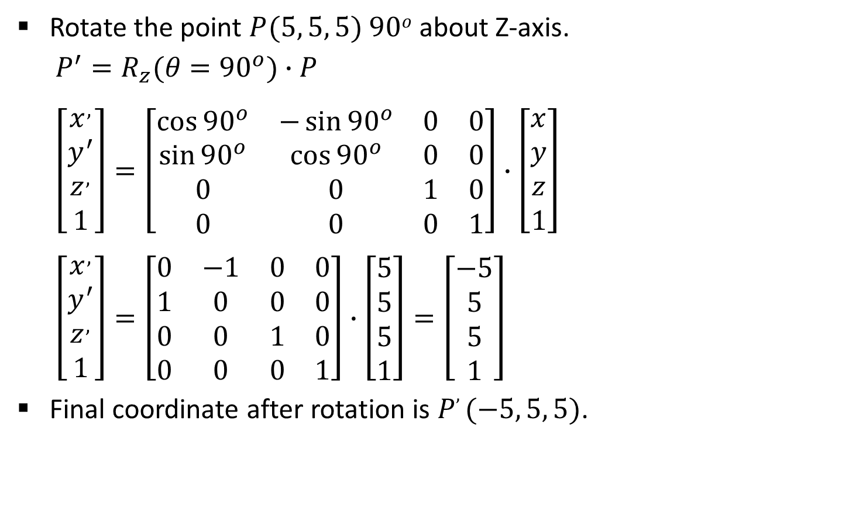
Example- Coordinate Axis Rotation
Rotate the point $P(5, 5, 5)$ $90o$ about Z-axis.
  $$P^{′}=R_{z}(θ={90}^{o})∙P$$
  $$\left[\begin{matrix}x^{,} \\ y^{′} \\ z^{,} \\ 1\end{matrix}\right]=\left[\begin{matrix}\cos{{90}^{o}} & −\sin{{90}^{o}} & 0 & 0 \\ \sin{{90}^{o}} & \cos{{90}^{o}} & 0 & 0 \\ 0 & 0 & 1 & 0 \\ 0 & 0 & 0 & 1\end{matrix}\right]∙\left[\begin{matrix}x \\ y \\ z \\ 1\end{matrix}\right]$$
  $$\left[\begin{matrix}x^{,} \\ y^{′} \\ z^{,} \\ 1\end{matrix}\right]=\left[\begin{matrix}0 & −1 & 0 & 0 \\ 1 & 0 & 0 & 0 \\ 0 & 0 & 1 & 0 \\ 0 & 0 & 0 & 1\end{matrix}\right]∙\left[\begin{matrix}5 \\ 5 \\ 5 \\ 1\end{matrix}\right]=\left[\begin{matrix}−5 \\ 5 \\ 5 \\ 1\end{matrix}\right]$$
Final coordinate after rotation is $P, (−5, 5, 5)$.

Slide 11
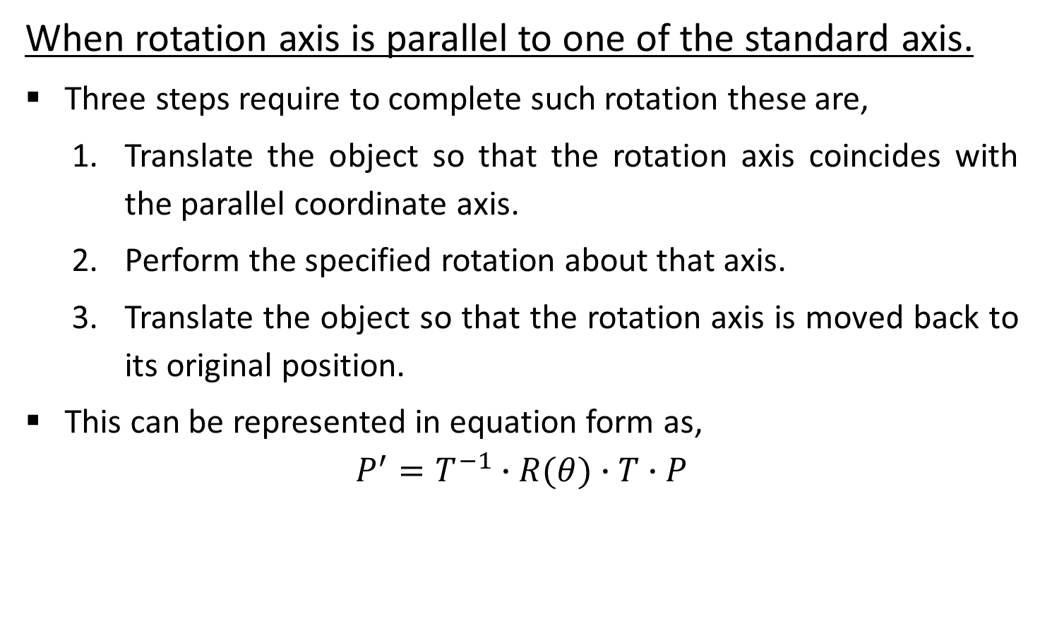
General 3D Rotations
When rotation axis is parallel to one of the standard axis.
Three steps require to complete such rotation these are,
  Translate the object so that the rotation axis coincides with the parallel coordinate axis.
  Perform the specified rotation about that axis.
  Translate the object so that the rotation axis is moved back to its original position.
This can be represented in equation form as,
$$P^{′}=T^{−1}∙R(θ)∙T∙P$$

Slide 12
General 3D Rotations
When rotation axis is inclined in arbitrary direction.
First we need rotations to align the axis with a selected coordinate axis and to bring the axis back to its original orientation.
Five steps require to complete such rotation these are,
  Translate the object so that the rotation axis passes through the coordinate origin.
  Rotate the object so that the axis of rotation coincides with one of the coordinate axes.
  Perform the specified rotation about that coordinate axis.
  Apply inverse rotations to bring the rotation axis back to its original orientation.
  Apply the inverse translation to bring the rotation axis back to its original position.

Slide 13

Contd.
We can transform rotation axis onto any of the three coordinate axes. The $Z−axis$ is a reasonable choice.
We are given line in the form of two end points $p_{1} (x_{1},y_{1},z_{1})$, and${ p}_{2} (x_{2},y_{2},z_{2})$.
Let’s discuss procedure step by step.

Slide 14



1. Translate the Object so that the Rotation Axis Passes Through the Coordinate Origin
For translation of step one we will bring first end point at origin and transformation matrix for the same is as below
  $$T=\left[\begin{matrix}1 & 0 & 0 & {−x}_{1} \\ 0 & 1 & 0 & {−y}_{1} \\ 0 & 0 & 1 & {−z}_{1} \\ 0 & 0 & 0 & 1\end{matrix}\right]$$
Y
$$p_{2}$$
$$p_{1}$$
X
Z

Slide 15
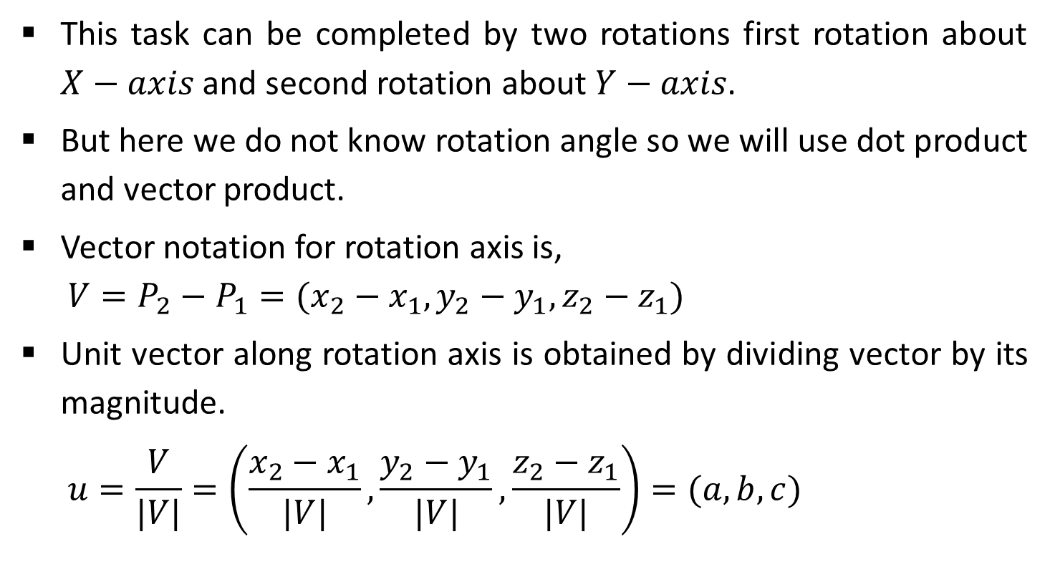
2. Rotate the Object so that the Axis of Rotation Coincides with One of the Coordinate Axes
This task can be completed by two rotations first rotation about $X−axis$ and second rotation about $Y−axis$.
But here we do not know rotation angle so we will use dot product and vector product.
Vector notation for rotation axis is,
  $$V=P_{2}−P_{1}=(x_{2}−x_{1},y_{2}−y_{1},z_{2}−z_{1})$$
Unit vector along rotation axis is obtained by dividing vector by its magnitude.
  $$u=\frac{V}{|V|}=\left(\frac{x_{2}−x_{1}}{|V|},\frac{y_{2}−y_{1}}{|V|},\frac{z_{2}−z_{1}}{|V|}\right)=(a,b,c)$$

Slide 16



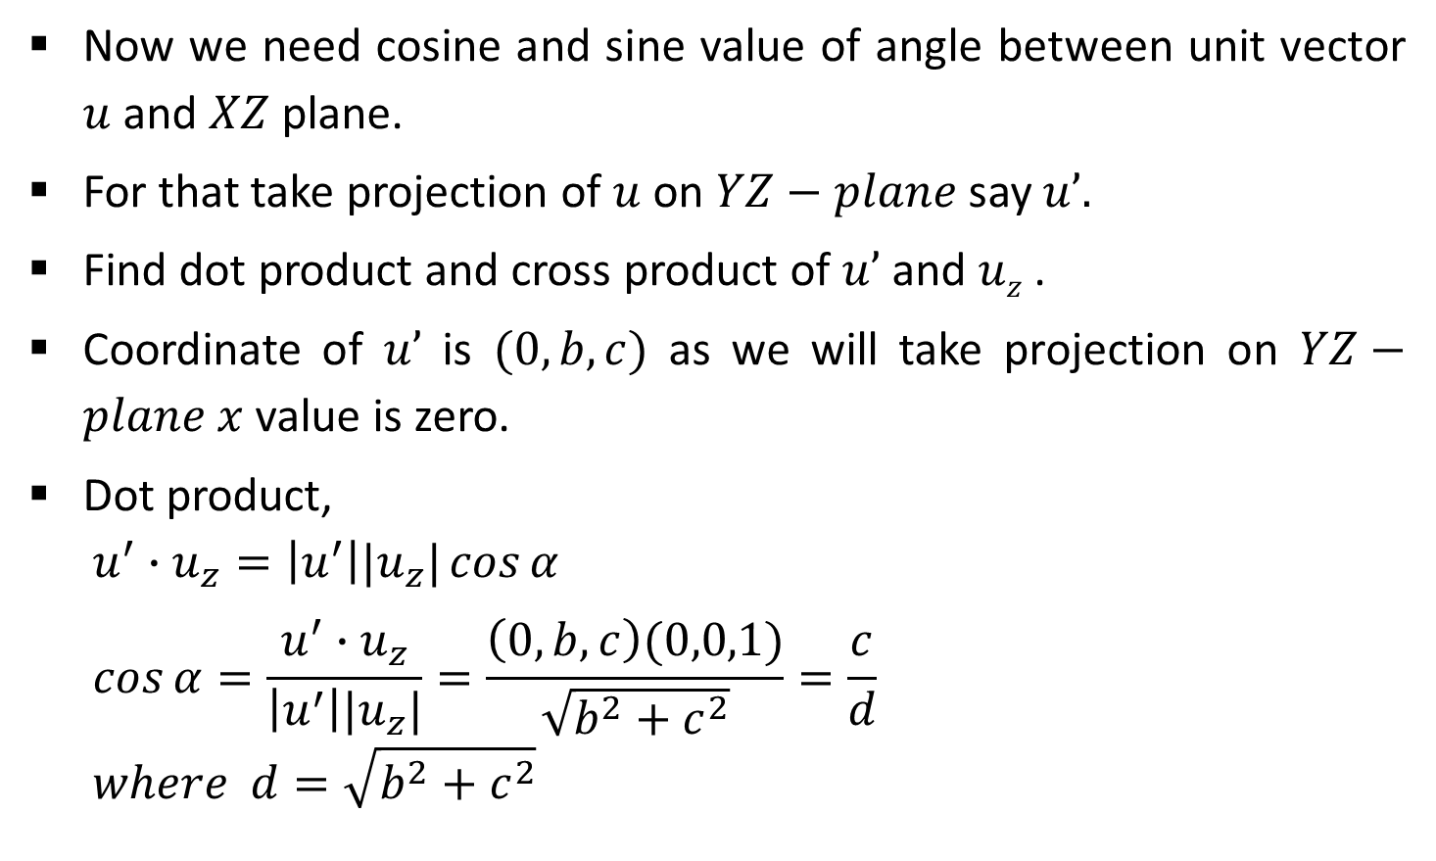




Contd.
Now we need cosine and sine value of angle between unit vector $u$ and $XZ$ plane.
For that take projection of $u$ on $YZ−plane$ say $u’.$
Find dot product and cross product of $u’$ and $uz$ .
Coordinate of $u’$ is $(0,b,c)$ as we will take projection on $YZ−plane$ $x$ value is zero.
Dot product,
  $$u^{′}∙u_{z}=\left|u^{′}\right||u_{z}|\cos{α}$$
  $$\cos{α}=\frac{u^{′}∙u_{z}}{\left|u^{′}\right||u_{z}|}=\frac{\left(0,b,c\right)(0,0,1)}{\sqrt{b^{2}+c^{2}}}=\frac{c}{d}$$
  $$where d=\sqrt{b^{2}+c^{2}}$$
$$Y$$
$$u’$$
$$u$$
$$α$$
$$X$$
$$uz$$
$$Z$$

Slide 17
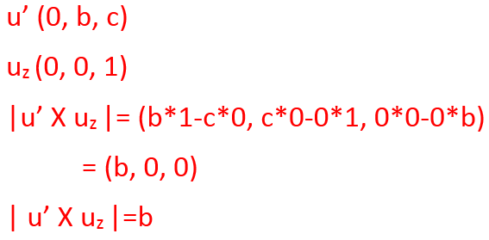

Contd.
Cross product,
  $u^{′}×u_{z}=u_{x}\left|u^{′}\right||u_{z}|\sin{α}$ …(1)
  $$u^{′}×u_{z}=u_{x}∙b …(2)$$
From (1) and (2),
  $$u_{x}\left|u^{′}\right||u_{z}|\sin{α=}u_{x}∙b$$
Comparing magnitude
  $$\left|u^{′}\right||u_{z}|\sin{α=}b$$
  $$\sqrt{b^{2}+c^{2}}∙(1)\sin{α=}b$$
  $$d\sin{α=}b$$
  $$\sin{α=}\frac{b}{d}$$
$$Y$$
$$u’$$
$$u$$
$$α$$
$$X$$
$$uz$$
$$Z$$

Slide 18
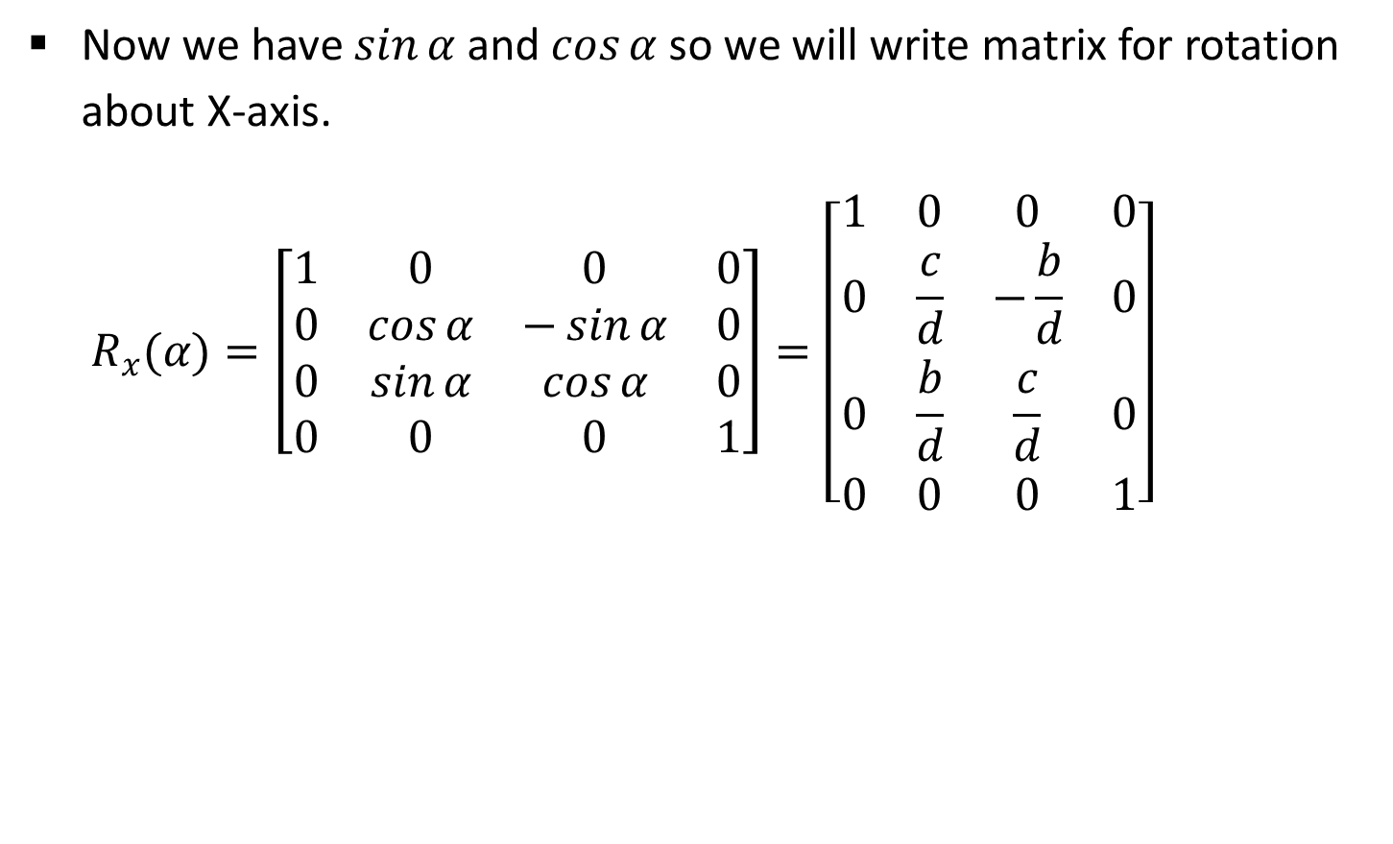
Contd.
Now we have $\sin{α}$ and $\cos{α}$ so we will write matrix for rotation about X-axis.
  $$R_{x}(α)=\left[\begin{matrix}1 & 0 & 0 & 0 \\ 0 & \cos{α} & −\sin{α} & 0 \\ 0 & \sin{α} & \cos{α} & 0 \\ 0 & 0 & 0 & 1\end{matrix}\right]=\left[\begin{matrix}1 & 0 & 0 & 0 \\ 0 & \frac{c}{d} & −\frac{b}{d} & 0 \\ 0 & \frac{b}{d} & \frac{c}{d} & 0 \\ 0 & 0 & 0 & 1\end{matrix}\right]$$

Slide 19



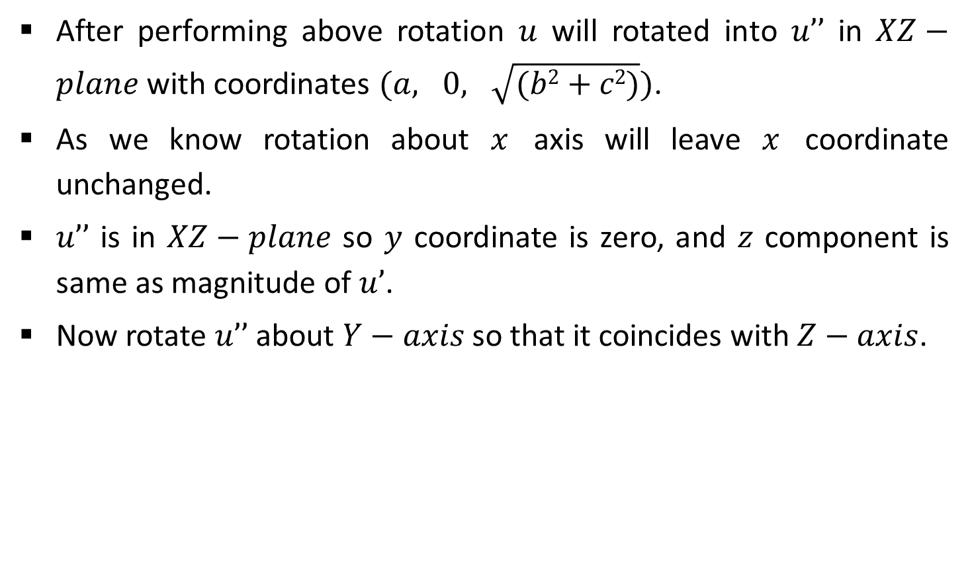




Contd.
After performing above rotation $u$ will rotated into $u’’$ in $XZ−plane$ with coordinates $(a, 0, \sqrt{(b2+c2)})$.
As we know rotation about $x$ axis will leave $x$ coordinate unchanged.
$u’’$ is in $XZ−plane$ so $y$ coordinate is zero, and $z$ component is same as magnitude of $u’$.
Now rotate $u’’$ about $Y−axis$ so that it coincides with $Z−axis$.
$$Y$$
$$u$$
$$u_{z}$$
$$X$$
$$β$$
$$u^{′′}$$
$$Z$$

Slide 20
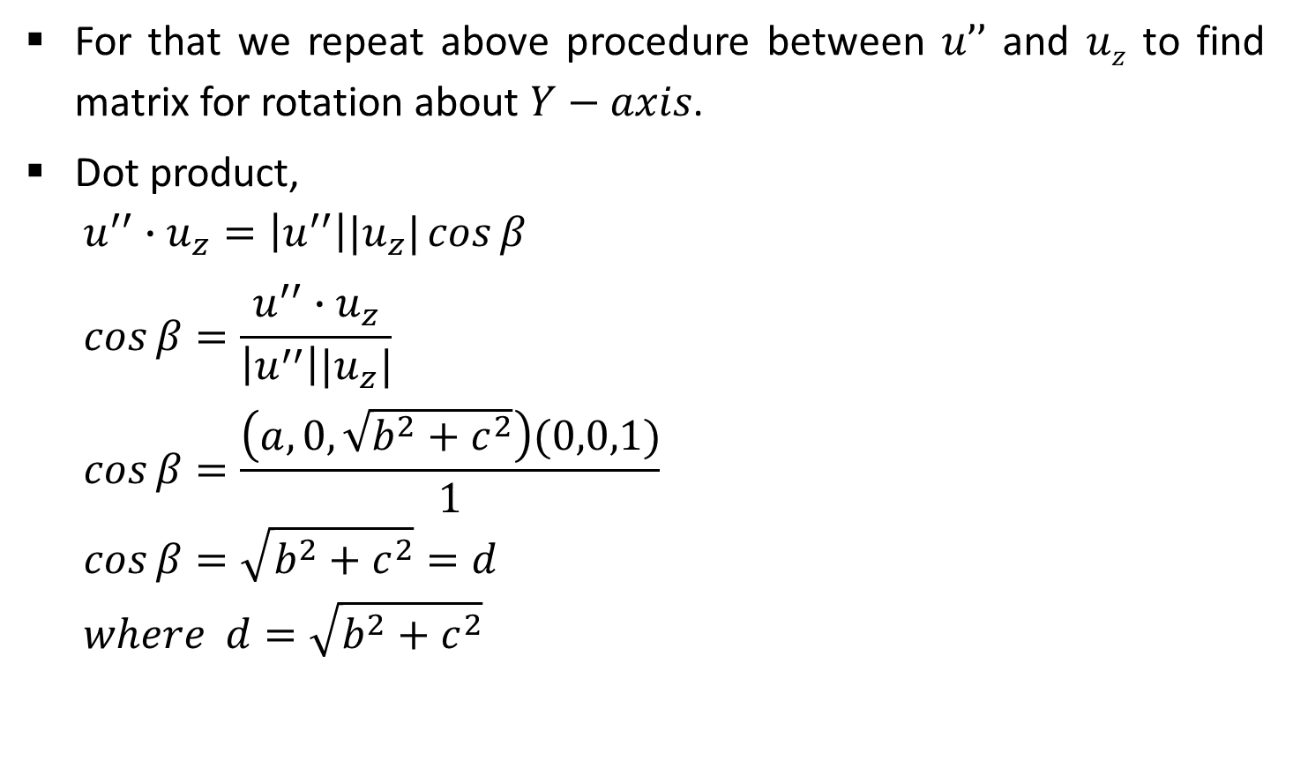
Contd.
For that we repeat above procedure between $u’’$ and $uz$ to find matrix for rotation about $Y−axis$.
Dot product,
  $$u^{′′}∙u_{z}=\left|u^{′′}\right||u_{z}|\cos{β}$$
  $$\cos{β}=\frac{u^{′′}∙u_{z}}{\left|u^{′′}\right||u_{z}|}$$
  $$\cos{β}=\frac{\left(a,0,\sqrt{b^{2}+c^{2}}\right)(0,0,1)}{1}$$
  $$\cos{β}=\sqrt{b^{2}+c^{2}}=d$$
  $$where d=\sqrt{b^{2}+c^{2}}$$
$$Y$$
$$u$$
$$u_{z}$$
$$X$$
$$β$$
$$u^{′′}$$
$$Z$$

Slide 21

Contd.
Cross product,
  $$u^{′′}×u_{z}=u_{y}\left|u^{′′}\right|\left|u_{z}\right|\sin{β} …(1)$$
  $$u^{′′}×u_{z}=u_{y}∙\left(−a\right)…(2)$$
From (1) and (2),
  $$u_{y}\left|u^{′′}\right|\left|u_{z}\right|\sin{β=}u_{y}∙(−a)$$
Comparing magnitude
  $$\left|u^{′′}\right|\left|u_{z}\right|\sin{β=}\left(−a\right)$$
  $$\left(1\right)\sin{β=}−a$$
  $$\sin{β=}−a$$
$$Y$$
$$u$$
$$u_{z}$$
$$X$$
$$β$$
$$u^{′′}$$
$$Z$$

Slide 22
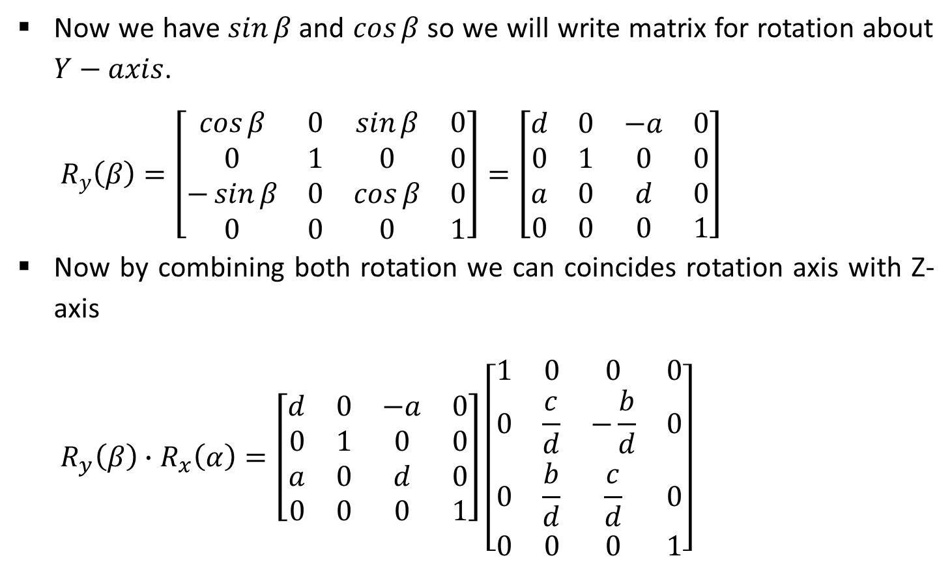
Contd.
Now we have $\sin{β}$ and $\cos{β}$ so we will write matrix for rotation about $Y−axis$.
  $$R_{y}\left(β\right)=\left[\begin{matrix}\cos{β} & 0 & \sin{β} & 0 \\ 0 & 1 & 0 & 0 \\ −\sin{β} & 0 & \cos{β} & 0 \\ 0 & 0 & 0 & 1\end{matrix}\right]=\left[\begin{matrix}d & 0 & −a & 0 \\ 0 & 1 & 0 & 0 \\ a & 0 & d & 0 \\ 0 & 0 & 0 & 1\end{matrix}\right]$$
Now by combining both rotation we can coincides rotation axis with Z-axis
  $$R_{y}\left(β\right)∙R_{x}\left(α\right)=\left[\begin{matrix}d & 0 & −a & 0 \\ 0 & 1 & 0 & 0 \\ a & 0 & d & 0 \\ 0 & 0 & 0 & 1\end{matrix}\right]\left[\begin{matrix}1 & 0 & 0 & 0 \\ 0 & \frac{c}{d} & −\frac{b}{d} & 0 \\ 0 & \frac{b}{d} & \frac{c}{d} & 0 \\ 0 & 0 & 0 & 1\end{matrix}\right]$$

Slide 23
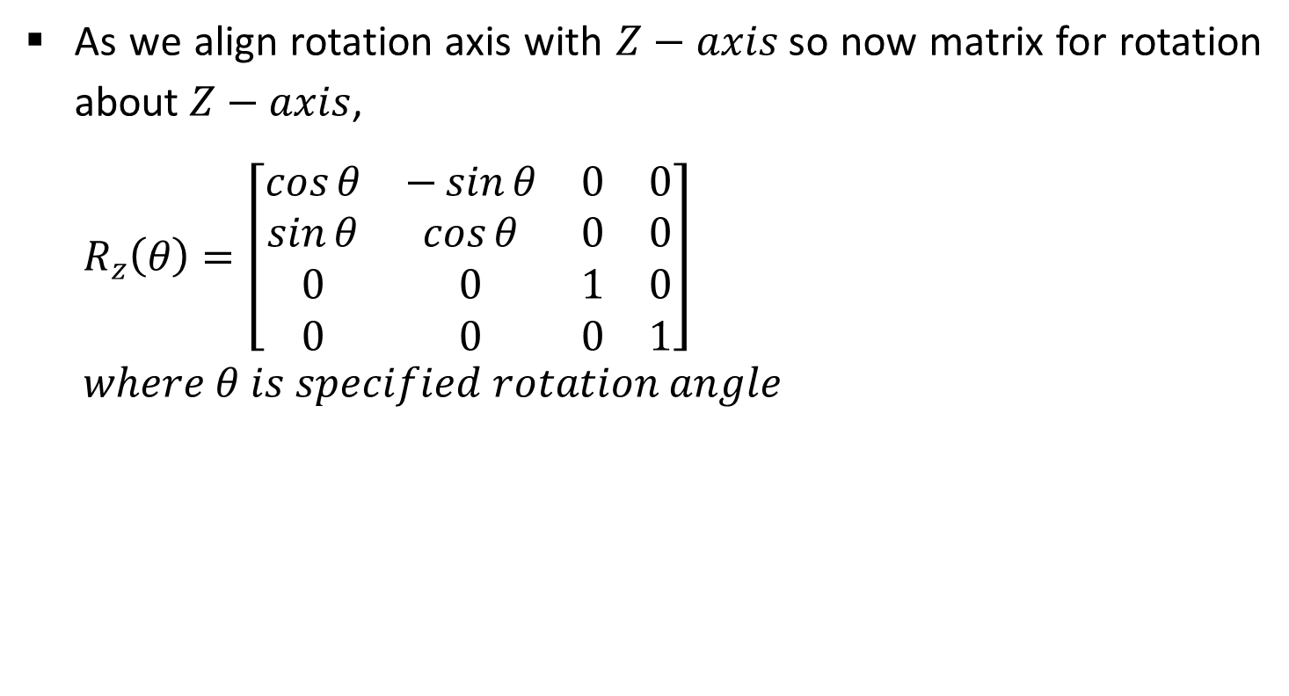
3. Perform the Specified Rotation About that Coordinate Axis
As we align rotation axis with $Z−axis$so now matrix for rotation about $Z−axis$,
  $$R_{z}\left(θ\right)=\left[\begin{matrix}\cos{θ} & −\sin{θ} & 0 & 0 \\ \sin{θ} & \cos{θ} & 0 & 0 \\ 0 & 0 & 1 & 0 \\ 0 & 0 & 0 & 1\end{matrix}\right]$$
  $$where θ is specified rotation angle$$

Slide 24

4. Apply Inverse Rotations to Bring the Rotation Axis Back to it’s Original Orientation
This step is inverse of step number 2,
  $$R_{x}^{−1}\left(α\right)∙R_{y}^{−1}\left(β\right)$$

Slide 25
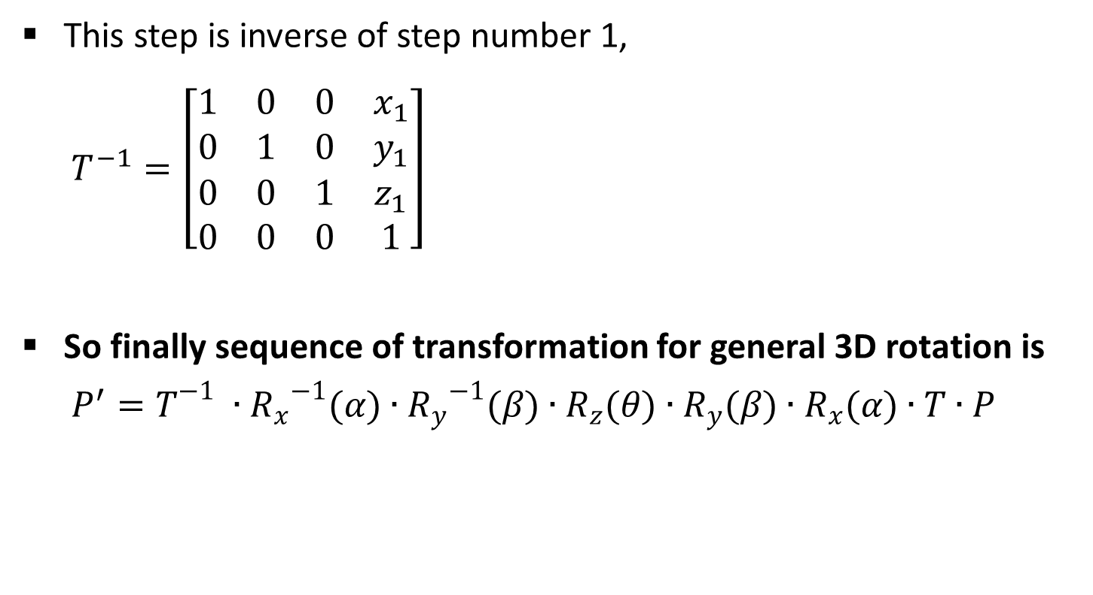
5. Apply the Inverse Translation to Bring the Rotation Axis Back to it’s Original Position
This step is inverse of step number 1,
  $$T^{−1}=\left[\begin{matrix}1 & 0 & 0 & x_{1} \\ 0 & 1 & 0 & y_{1} \\ 0 & 0 & 1 & z_{1} \\ 0 & 0 & 0 & 1\end{matrix}\right]$$
So finally sequence of transformation for general 3D rotation is
  $$P^{′}=T^{−1}∙{R_{x}}^{−1}(α)∙{R_{y}}^{−1}(β)∙R_{z}(θ)∙R_{y}(β)∙R_{x}(α)∙T∙P$$

Slide 26
Scaling
It is used to resize the object in 3D space.
We can apply uniform as well as non uniform scaling by selecting proper scaling factor.
Scaling in 3D is similar to scaling in 2D. Only one extra coordinate need to consider into it.

Slide 27


Coordinate Axes Scaling
Simple coordinate axis scaling can be performed as below,
  $$P^{′}=S∙P$$
  $$\left[\begin{matrix}x^{,} \\ y^{′} \\ z^{,} \\ 1\end{matrix}\right]=\left[\begin{matrix}s_{x} & 0 & 0 & 0 \\ 0 & s_{y} & 0 & 0 \\ 0 & 0 & s_{z} & 0 \\ 0 & 0 & 0 & 1\end{matrix}\right]∙\left[\begin{matrix}x \\ y \\ z \\ 1\end{matrix}\right]$$
$$Y$$
Scaling
X
Z

Slide 28
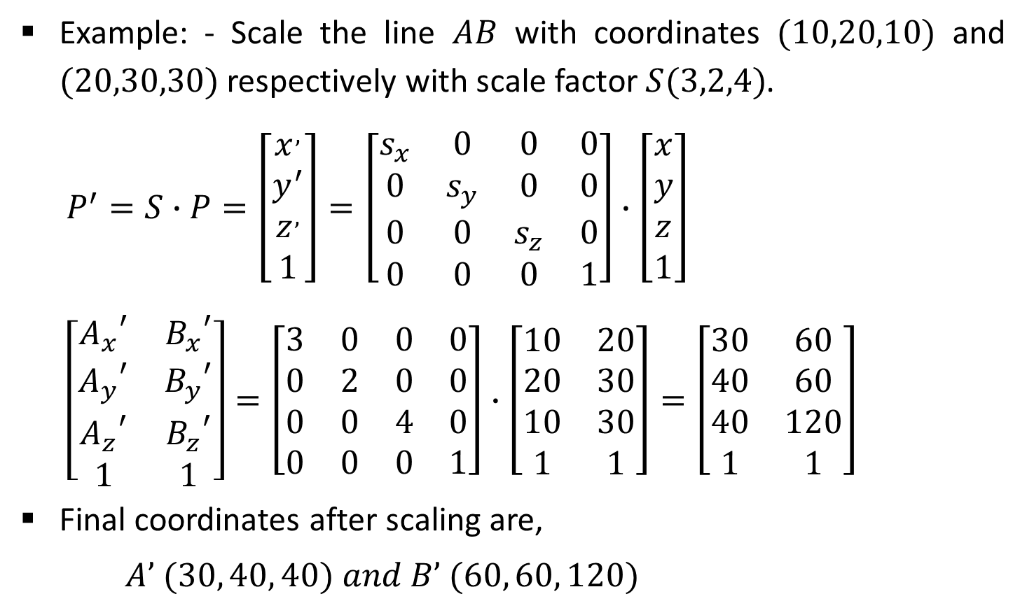
Example-Coordinate Axes Scaling
Example: - Scale the line $AB$ with coordinates $(10,20,10)$ and $(20,30,30)$ respectively with scale factor $S(3,2,4)$.
  $$P^{′}=S∙P=\left[\begin{matrix}x^{,} \\ y^{′} \\ z^{,} \\ 1\end{matrix}\right]=\left[\begin{matrix}s_{x} & 0 & 0 & 0 \\ 0 & s_{y} & 0 & 0 \\ 0 & 0 & s_{z} & 0 \\ 0 & 0 & 0 & 1\end{matrix}\right]∙\left[\begin{matrix}x \\ y \\ z \\ 1\end{matrix}\right]$$
  $$\left[\begin{matrix}{A_{x}}^{′} & {B_{x}}^{′} \\ {A_{y}}^{′} & {B_{y}}^{′} \\ {A_{z}}^{′} & {B_{z}}^{′} \\ 1 & 1\end{matrix}\right]=\left[\begin{matrix}3 & 0 & 0 & 0 \\ 0 & 2 & 0 & 0 \\ 0 & 0 & 4 & 0 \\ 0 & 0 & 0 & 1\end{matrix}\right]∙\left[\begin{matrix}10 & 20 \\ 20 & 30 \\ 10 & 30 \\ 1 & 1\end{matrix}\right]=\left[\begin{matrix}30 & 60 \\ 40 & 60 \\ 40 & 120 \\ 1 & 1\end{matrix}\right]$$
Final coordinates after scaling are,
$A’ (30, 40, 40) and B’ (60, 60, 120)$

Slide 29

Fixed Point Scaling
Fixed point scaling is used when we require scaling of object but particular point must be at its original position.
Three steps require to complete such fixed point scaling these are,
  Translate the fixed point to the origin.
  Scale the object relative to the coordinate origin using coordinate axes scaling.
  Translate the fixed point back to its original position.
$$Y$$
Fixed Point
X
Z

Slide 30
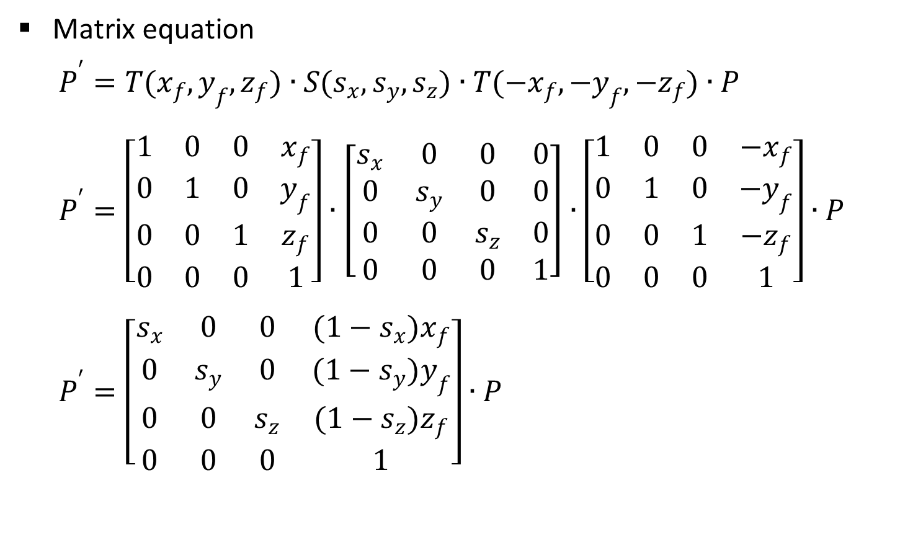
Contd.
Matrix equation
  $$P^{′}=T(x_{f},y_{f},z_{f})∙S(s_{x},s_{y},s_{z})∙T({−x}_{f},{−y}_{f},{−z}_{f})∙P$$
  $$P^{′}=\left[\begin{matrix}1 & 0 & 0 & x_{f} \\ 0 & 1 & 0 & y_{f} \\ 0 & 0 & 1 & z_{f} \\ 0 & 0 & 0 & 1\end{matrix}\right]∙\left[\begin{matrix}s_{x} & 0 & 0 & 0 \\ 0 & s_{y} & 0 & 0 \\ 0 & 0 & s_{z} & 0 \\ 0 & 0 & 0 & 1\end{matrix}\right]∙\left[\begin{matrix}1 & 0 & 0 & {−x}_{f} \\ 0 & 1 & 0 & {−y}_{f} \\ 0 & 0 & 1 & {−z}_{f} \\ 0 & 0 & 0 & 1\end{matrix}\right]∙P$$
  $$P^{′}=\left[\begin{matrix}s_{x} & 0 & 0 & (1−s_{x})x_{f} \\ 0 & s_{y} & 0 & (1−s_{y})y_{f} \\ 0 & 0 & s_{z} & (1−s_{z})z_{f} \\ 0 & 0 & 0 & 1\end{matrix}\right]∙P$$

Slide 31
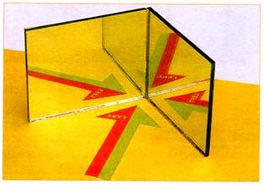
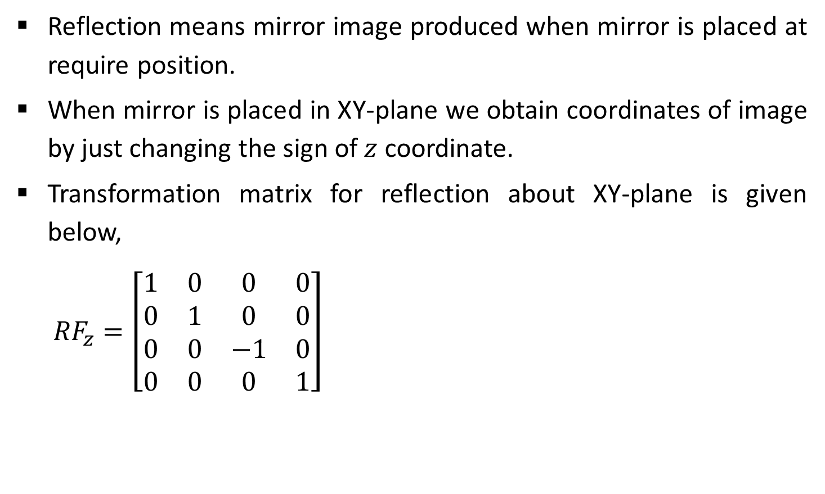
Other Transformations-Reflection
Reflection means mirror image produced when mirror is placed at require position.
When mirror is placed in XY-plane we obtain coordinates of image by just changing the sign of $z$ coordinate.
Transformation matrix for reflection about XY-plane is given below,
  $${RF}_{z}=\left[\begin{matrix}1 & 0 & 0 & 0 \\ 0 & 1 & 0 & 0 \\ 0 & 0 & −1 & 0 \\ 0 & 0 & 0 & 1\end{matrix}\right]$$
Source: http://www.yourarticlelibrary.com

Slide 32
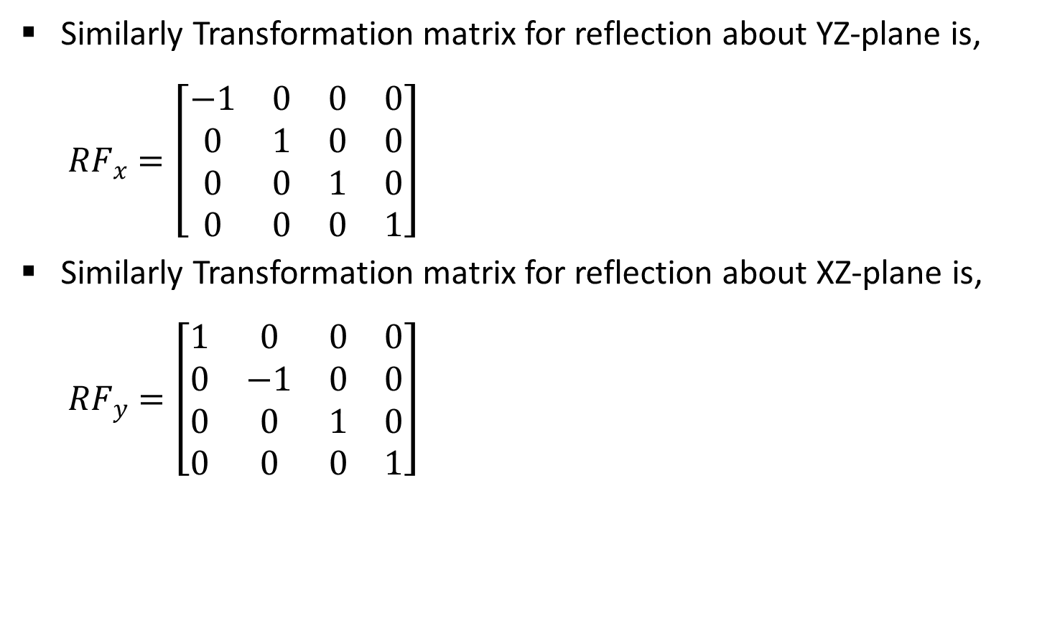
Contd.
Similarly Transformation matrix for reflection about YZ-plane is,
  $${RF}_{x}=\left[\begin{matrix}−1 & 0 & 0 & 0 \\ 0 & 1 & 0 & 0 \\ 0 & 0 & 1 & 0 \\ 0 & 0 & 0 & 1\end{matrix}\right]$$
Similarly Transformation matrix for reflection about XZ-plane is,
  $${RF}_{y}=\left[\begin{matrix}1 & 0 & 0 & 0 \\ 0 & −1 & 0 & 0 \\ 0 & 0 & 1 & 0 \\ 0 & 0 & 0 & 1\end{matrix}\right]$$

Slide 33
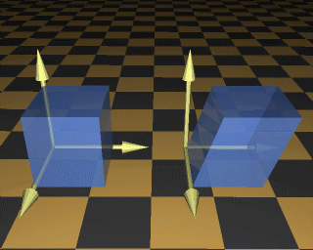
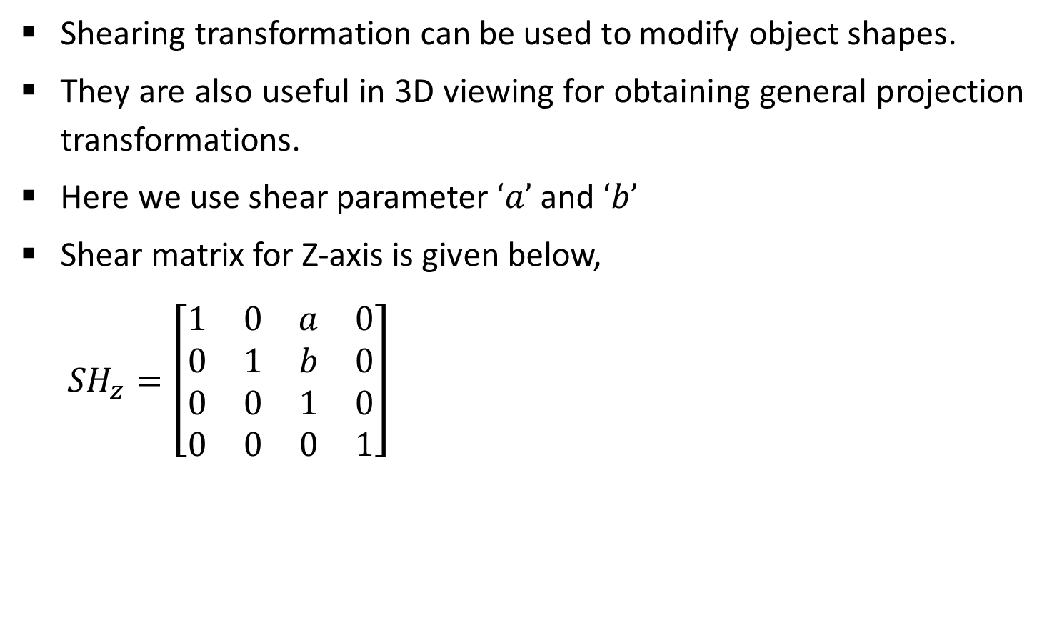
Other Transformations-Shear
Shearing transformation can be used to modify object shapes.
They are also useful in 3D viewing for obtaining general projection transformations.
Here we use shear parameter $‘a’$ and $‘b’$
Shear matrix for Z-axis is given below,
  $${SH}_{z}=\left[\begin{matrix}1 & 0 & a & 0 \\ 0 & 1 & b & 0 \\ 0 & 0 & 1 & 0 \\ 0 & 0 & 0 & 1\end{matrix}\right]$$
Source: http://140.129.20.249/~jmchen/cg

Slide 34

Other Transformations-Shear
Similarly Shear matrix for X-axis is,
  $${SH}_{x}=\left[\begin{matrix}1 & 0 & 0 & 0 \\ a & 1 & 0 & 0 \\ b & 0 & 1 & 0 \\ 0 & 0 & 0 & 1\end{matrix}\right]$$
Similarly Shear matrix for Y-axis is,
  $${SH}_{y}=\left[\begin{matrix}1 & a & 0 & 0 \\ 0 & 1 & 0 & 0 \\ 0 & b & 1 & 0 \\ 0 & 0 & 0 & 1\end{matrix}\right]$$

Slide 35
Thank You

